Slide 1
Reader Performance:
Detection and Monitoring a
David Raunig, Ph.D.
Medical and Scientific Affairs
ICON Clinical Research
Imaging
26 February 2016

Slide 2
Why do we measure performance?
Measurement is the first step that leads to control and eventually to improvement. If you can't measure something, you can't understand it. If you can't understand it, you can't control it. If you can't control it, you can't improve it."- H. James Harrington
"Far better an approximate answer to the right question, which is often vague, than an exact answer to the wrong question, which can always be made precise." - John W. Tukey 1962
The answer is not to satisfy an ODAC or FDA requirement but to detect, monitor and track the calibration of the measurement instrument for the clinical study endpoint, much the same as any measuring instrument.

Slide 3
Agenda
Objectives of Performance Monitoring
Background
Multiple Readers and Accuracy
Disagreement
Evaluation – Why and How
Inter- versus Intra-Reader Performance
Conclusions

Slide 4
Objectives of Performance Measurement
Primary Objective
  Identify a single reader whose performance is degraded to the point that action should be taken in order to preserve the integrity of the data
Secondary Objective
  To identify any trends that indicate either a significant bias or error with respect to the protocol-defined criteria and indicates that the readers, as a whole, need recalibration

Slide 5
Background

Slide 6
Background
Clinton-Kessler Oncology Initiative (1996)
  Tumor size evidence of benefit
  Imaging-based endpoints
  No defined process
  RECIST in development
Diagnostic Agents and Medical Practice
  Variability between readers
  Multiple opinions but one endpoint
ODAC
  40% Discordance = Questionable data quality
  No clear reason why 40% is the threshold

Slide 7

Reader Performance Guidelines
“We recommend that at least two blinded readers (and preferably three or more) evaluate images for each study that is intended to demonstrate efficacy…”
“The use of multiple readers allows for an evaluation of the reproducibility of the readings (i.e., interreader variability) …. “
“We recommend that consistency among readers be measured quantitatively (e.g., with the kappa statistic).”
Notes:
t=00:50
Bottom Line:
The reader is an evaluation instrument that is subject to variability, bias and drift.
Calibration should occur as it would with any instrument
Bottom Line:
The reader is an evaluation instrument that is subject to variability, bias and drift.
Calibration should occur as it would with any instrument

Slide 8
Medical Rater Bias –
According to Dr. R. Owen, 1982, JAMA
Rivalry
Personal habit
Moral
Clinical practice
Do Something
Favored design
Resource allocation
Prestigious journal
Prominent author
Famous institution
Flashy title
Subtracted question
Credential
Esteemed professor
Bankbook
Friendship
Omission
Tradition
…
I am an epidemiologist

Slide 9
Multiple readers and Accuracy

Slide 10
‘Two Readers are Better than One’
Hypothesis: If two well-trained readers agree, then they are likely to be correct
Assumption
  All readers are well-trained
  All readers are equally trained
  The average reader is unbiased
  More readers → Better average
Most common protocol:
  Majority Rules
  2 readers / 1 adjudicator
  Disagreements are resolved with a third reader
Multiple Readers per image
  Better Operating Characteristics
  Evaluation of each other’s performance
Multi-Reader ROC Curve
1
0.9
0.8
0.7
0.6
True Positive Rate
0.5
0.4
1 Reader
0.3
3 Readers
5 Readers
0.2
0.1
0
0
0.1
0.2
0.3
0.4
0.5
0.6
0.7
0.8
0.9
1
False Positive Rate
10
10
10
Notes:
t=1:00

Slide 11
Assumptions of Reader Performance Monitoring
Well and equally capable
  They should have an accuracy rate that is about 80% or greater – including the adjudicator
    Pr(Rdr1= Correct & Rdr2=Correct ) = 64%)
    Pr(Rdr1= Wrong & Rdr2=Wrong ) < 4%)
    Pr(Correct) = 64% + 32%*70% = 87%
  Less capable readers mean more variability and larger teams
Unbiased
  Independent within patients
  Correlated only by the patient and/or lesion
  Blinded to treatment

Slide 12
Disagreement a normal expected result

Slide 13
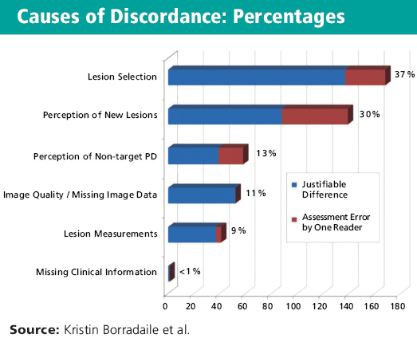
Discordance

Slide 14
Reader Agreement with Equal Performance
Disagree
p01
Rdr 1
Agree
p11
Symmetric Disagreement
Correlation
Rdr 2
Agree
p00
Disagree
p10
14
Notes:
t=2:00
There is a complex relationship between bias, prevalence, performance heterogeneity and agreement that is not easily
distilled into a single summary metric. Therefore, the metric for agreement of patient categorical classification and the conditional independence of the 2 readers.

Slide 15
Reader Agreement with Increased Prevalence
Disagree
p01
Agree
p11
Rdr 1
Same Results: Agreement has a large chance component
Rdr 2
Agree
p00
Disagree
p10
15
Notes:
t=2:00
There is a complex relationship between bias, prevalence, performance heterogeneity and agreement that is not easily
distilled into a single summary metric. Therefore, the metric for agreement of patient categorical classification and the conditional independence of the 2 readers.

Slide 16
Reader Agreement with Severe Reader 2 Bias
Disagree
p01
Rdr 1
Agree
p11
Asymmetric Disagreement
Rdr 2
Agree
p00
Disagree
p10
16
Notes:
t=2:00
There is a complex relationship between bias, prevalence, performance heterogeneity and agreement that is not easily
distilled into a single summary metric. Therefore, the metric for agreement of patient categorical classification and the conditional independence of the 2 readers.

Slide 17
Reader Performance and Agreement
Assumption:
  Agreement⬇ = Performance⬇
Reality
  ΔAgreement → Something changed!
Requirements for a Reliable Metric
  Consistent
  Bounded
  Comparable
  Defined statistical properties
Reader Agreement Statistics
  Agreement has limited usefulness
 |  | Reader B
 |  | Cat 1 | Cat0
Reader A | Cat 1 | p11 | p10 | p1.
 | Cat0 | p01 | p00 | p0.
 |  | p.1 | p.0 | N_{total}
17
17
17
Notes:
t=1:25

Slide 18
Agreement/Disagreement for Date of Progression
 |  |  | Rdr 1
 |  |  | Visit |  |  |  |  |  |  |  |  |  | Total
 |  |  | 1 | 2 | 3 | 4 | 5 | 6 | 7 | 8 | 9 | 10
Rdr 2 | Visit | 1 | 24 | 12 | 1 | 0 | 0 | 1 | 0 | 0 | 0 | 0 | 38
 |  | 2 | 11 | 66 | 32 | 4 | 0 | 0 | 1 | 0 | 0 | 0 | 114
 |  | 3 | 1 | 19 | 55 | 22 | 3 | 0 | 1 | 1 | 0 | 1 | 103
 |  | 4 | 1 | 5 | 14 | 44 | 12 | 5 | 2 | 0 | 0 | 0 | 83
 |  | 5 | 0 | 3 | 4 | 12 | 27 | 12 | 1 | 1 | 0 | 0 | 60
 |  | 6 | 0 | 0 | 0 | 4 | 6 | 16 | 7 | 0 | 0 | 1 | 34
 |  | 7 | 0 | 0 | 1 | 1 | 2 | 8 | 5 | 0 | 0 | 0 | 17
 |  | 8 | 0 | 0 | 0 | 0 | 0 | 1 | 0 | 5 | 0 | 0 | 6
 |  | 9 | 0 | 0 | 0 | 0 | 0 | 0 | 0 | 2 | 4 | 0 | 6
 |  | 10 | 0 | 0 | 0 | 1 | 0 | 1 | 0 | 0 | 0 | 1 | 3
Total |  |  | 37 | 105 | 107 | 88 | 50 | 44 | 17 |  | 4 | 3 | 455

Slide 19
Evaluation
Why and how

Slide 20
What Can We Measure with 2+1 Readers
Agreement
  between the 2 primary readers
Disagreement profile
  Does one reader call differently than the other(s) in a systematic fashion
Resolution
  Adjudication Selection
  Does the adjudicator choose one reader over another?

Slide 21
Agreement/Disagreement for Date of Progression
 |  |  | Rdr 1
 |  |  | Visit |  |  |  |  |  |  |  |  |  | Total
 |  |  | 1 | 2 | 3 | 4 | 5 | 6 | 7 | 8 | 9 | 10
Rdr 2 | Visit | 1 | 24 | 12 | 1 | 0 | 0 | 1 | 0 | 0 | 0 | 0 | 38
 |  | 2 | 11 | 66 | 32 | 4 | 0 | 0 | 1 | 0 | 0 | 0 | 114
 |  | 3 | 1 | 19 | 55 | 22 | 3 | 0 | 1 | 1 | 0 | 1 | 103
 |  | 4 | 1 | 5 | 14 | 44 | 12 | 5 | 2 | 0 | 0 | 0 | 83
 |  | 5 | 0 | 3 | 4 | 12 | 27 | 12 | 1 | 1 | 0 | 0 | 60
 |  | 6 | 0 | 0 | 0 | 4 | 6 | 16 | 7 | 0 | 0 | 1 | 34
 |  | 7 | 0 | 0 | 1 | 1 | 2 | 8 | 5 | 0 | 0 | 0 | 17
 |  | 8 | 0 | 0 | 0 | 0 | 0 | 1 | 0 | 5 | 0 | 0 | 6
 |  | 9 | 0 | 0 | 0 | 0 | 0 | 0 | 0 | 2 | 4 | 0 | 6
 |  | 10 | 0 | 0 | 0 | 1 | 0 | 1 | 0 | 0 | 0 | 1 | 3
Total |  |  | 37 | 105 | 107 | 88 | 50 | 44 | 17 |  | 4 | 3 | 455

Slide 22
Longitudinal Agreement Rates
Trends or Random Variability
1
0.9
0.8
0.7
0.6
Percent Disagreement (P=0.48)
0.5
0.4
0.3
0.2
0.1
0
1
2
3
4
5
6
7
8
9
10
11
12
Visit

Slide 23
Agreement for Date of Progression Windows

Slide 24
P-Chart for Adjudicator Selection

Slide 25
Common and Uncommon
Reader Performance Metrics
Common
  Scaled
    Adjudication (Disagreement) Rate
    Kappa
    Intra- and Inter-Class Correlation
  Unscaled
    Inter- and Intra-Reader Variance
    Selection Rate (semantics)
Uncommon
  Quasi-Symmetry
  Models for latent class identification

Slide 26
Adjudication Rate and Beyond
What is an acceptable Adjudication Rate?
  Depends:
  What is being measured!?
  How many endpoints?
  What is the denominator?
Symmetric Disagreement
  General agreement among statisticians that this is important
Latent Class Models
  Can determine if 2 classes of readers might exist
  Gaining somewhat in visibility
Real-Time Individual Reader Performance
  In progress

Slide 27
Comprehensive reader performance management
Goals: Sensitivity to performance; discriminate from randomness
Statistical modeling intra- and inter-reader variability
  Adjudication Rate measures accuracy and consistency
  Intra-Reader Agreement measures consistency
Symmetric Disagreement and Selection
  Longitudinal Reader Tracking (in development)
    Premise: patient populations don’t change quickly and abrupt changes are yellow-flags
    Differentiate changing performance from random variability
  Finally: In-depth radiological review of any suspicious trend
Reader Preference Plot with Control Boundaries
U99L
Percentage Selected by Adj
U90L
0.5
L90L
L99L
0
A
B
C
Reader
D
E
F

Slide 28
Inter- versus intra-reader

Slide 29
What is the difference between inter- and intra
Total variance
  Inter-reader +
  Intra-reader +
  Biological +
  Imaging
Inter-reader variability
  Minimized by reader training
  Not minimized by same-lesion selection!!!
Intra-reader variability
  Consistency, nothing more
  Not an evaluation of accuracy
  Minimized by training

Slide 30
Conclusions
Adjudication rate is a very blunt instrument and tells you nothing specific about reader performance
Metrics are just that and by themselves do not provide little information on reader performance unless evaluated as an integrated whole
Change in reader performance is much more important than a single snapshot

Slide 31
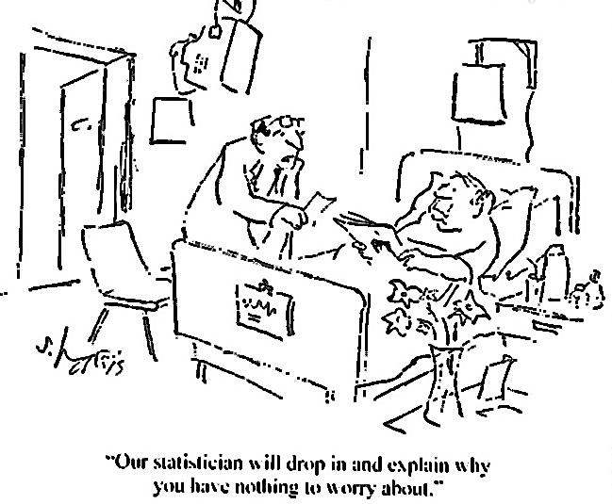
Discussion

