Slide 1
PINTAD
Handover Meeting
31JUL2020 – F Ricard – v1

Slide 2
New PINTAD management Team
LT
Fabien Ricard MD
Director, global Clinical Development
Bayer Pharmaceuticals
Brenda Kurland PhD
Senior Principal Statistician, Imaging
ERT
Communication Manager
Julie Gillis MPH
Lead Consultant
Merigold
Melissa Burkett CNMT
Global PET Applications Leader
GE Healthcare
Gregory Goldmacher MD
Exec. Director, Head of Clinical Imaging
Merck
Steering
Committee
Can Akgun PhD
VP, Business Development
Flywheel.io
Colin Miller PhD
Managing Partner
The Bracken Group
Annette Schmid PhD
Sr Director, Global Science Policy
Takeda
xxx

Slide 3
New PINTAD multidisciplinary management Team
Fabien Ricard MD
Director, global Clinical Development
Bayer Pharmaceuticals
Clinical development
Brenda Kurland PhD
Senior Principal Statistician, Imaging
ERT
therapeutics
statistics
iCRO
Julie Gillis MPH
Lead Consultant
Merigold
Radiology
Nuclear Medicine
Medical writing
academia
Melissa Burkett CNMT
Global PET applications Leader
GE Healthcare
Gregory Goldmacher MD
Exec. Director, head of clinical Imaging
Merck
Response criteria
Data management
diagnostics
AI
PET
Can Akgun PhD
VP, business development
Flywheel.io
Colin Miller PhD
Managing Partner
The Bracken Group
radiopharmaceuticals
Pharma industry
Non oncology imaging
Oncology imaging
Annette Schmid PhD
Sr Director, global science policy
Takeda
xxx
Policy

Slide 4
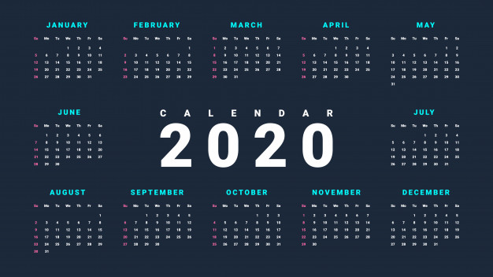
OPERATIONS
Last Friday of every month
keep same monthly schedule
keep same 11am ET timeslot
no PINTAD session in August
December session tbd
Teams meeting
video-capable
chat, Q&A, and poll functions
moderation of PINTAD sessions by a SC member (or designee)
Rotation in topics: oncology/non-oncology, clinical/early clinical-TS

Slide 5
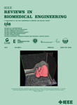
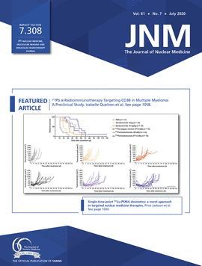
SESSIONS FORMAT
Interactive sessions with rotating Moderator, Q&A and polls
Diversity with rotating topics
Oncology vs non-oncology
Clinical vs early clinical/translational
Fit-for-purpose sessions
Standard session
Panel meeting
Journal club

Slide 6
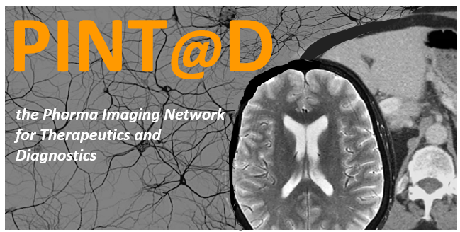
STRATEGIC VISION
Engaging the PINTAD multidisciplinary community
general PINTAD audience
Academia and Industry
Imaging and Clinical
Regulators (diagnostics and therapeutics)
annual global regulatory PINTAD meeting (EU and NA)
Communicating the PINTAD
Presence on LinkedIn
Publication strategy*
Enhancing the PINTAD
Working groups strategy*
Platform for dialogue and consensus among regulatory, industry, academia/IWG

Slide 7
SUBGROUP STRATEGY
PUBLICATION STRATEGY
For selected topics with more impact on the scientific community
Large and complementary representation within the PINTAD
Standardization of new response criteria
Feedback on regulatory topics
Follow the model of the PROLOG
SC and 4 TF (working groups)
Update about PROLOG
Creating a bank of publication on behalf of the PINTAD network
Paper on reads variability submitted Q3 2020
Paper on Lugano from PROLOG scheduled Q4 2020
Publication from subgroups, consensus, recommendations …

Slide 8
Topics for PINTAD sessions
Response Criteria
IT-RECIST
iRECIST*
RECIL*
Beyond RECIST1.1: CNS efficacy (RECIST and RANO BM), pediatric assessments
AI in clinical trials and impact on imaging
Acquisition, reads, data management
Impact of COVID19/pandemic situation on imaging for clinical trials
Decentralized trials / patient centered trials
Theragnostics
Radionuclide therapy
Non-oncologic topics
MSK, MS…
imaging biomarkers – molecular imaging companion diagnostics
Translational imaging – targeted therapy
Regulatory meetings

Slide 9
Thank you!
On behalf of the new PINTAD team
fabien.ricard@bayer.com
brenda.kurland@ert.com
jcgillis@merigoldcommunications.com

