Slide 1
What quality does pharma expect in multi-center FDG-PET studies?
PINTAD Call
08Sep2017
Paul Galette and Neel Patel
Experimental Medicine Imaging, GSK

Slide 2
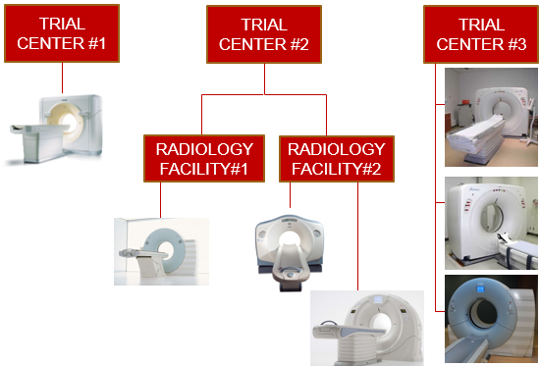
Standardization and FDG in multi-center trials
Site selection
Feasibility
Does the research center have a relationship
with the imaging center?
Expertise and equipment readily available?
Anonymization method/software?
Qualification
Equipment surveys
Phantom assessments (per certifying body such as ACRIN CQIE, EANM EARL, SNMMI-CTN)?

Slide 3
Standardization and FDG in multi-center trials
Imaging Manual
Acquisition requirements/guidelines document
Site training/qualification
Quality Control
Prospective and detailed!!
Communication between sponsor/center/CRO
Central image interpretation
Charter with full analysis methods, software used, variables collected

Slide 4
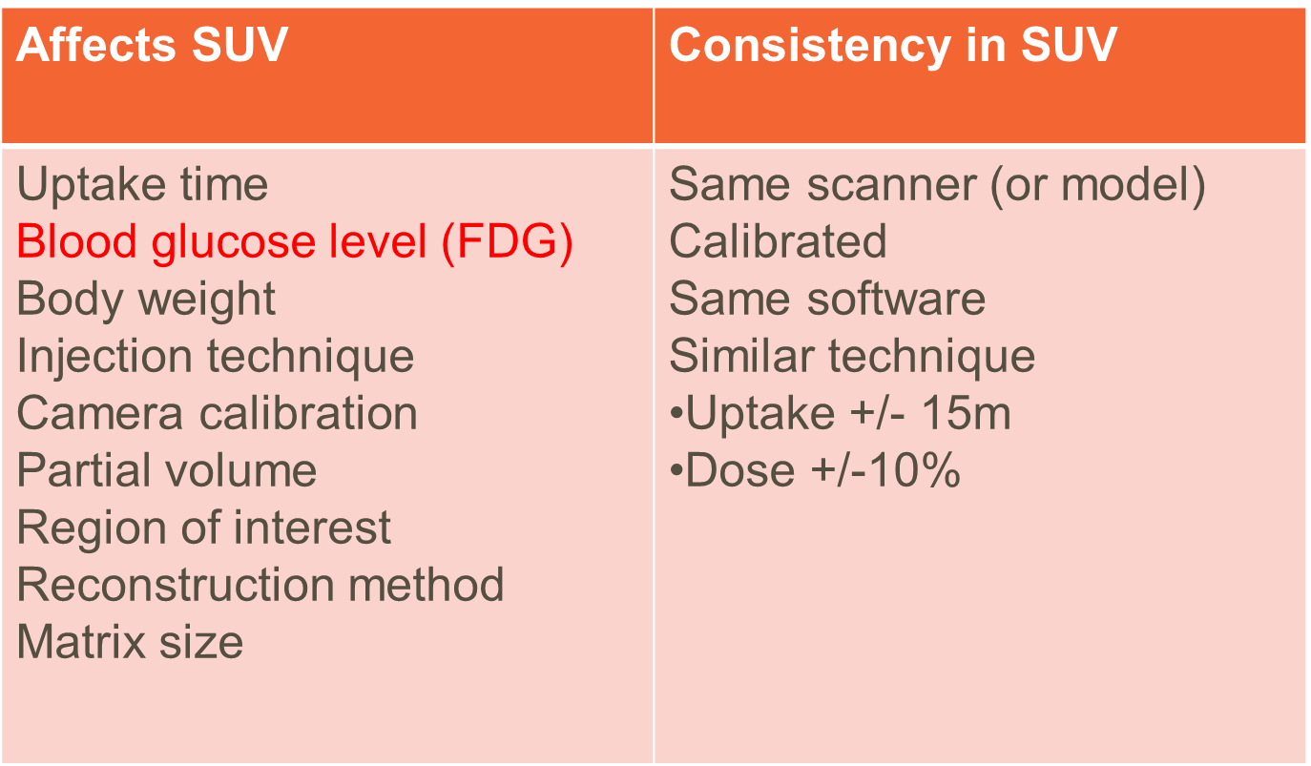
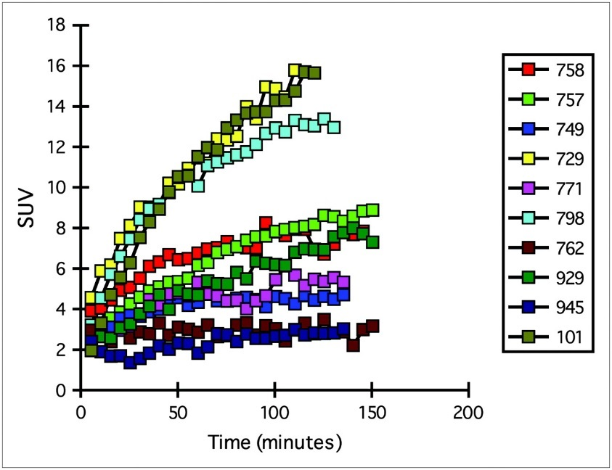
Factors that affect SUV
Semi-quantitative analysis
TACs for 10 patients with solitary pulmonary nodules
Lalitha K. Shankar et al. J Nucl Med 2006;47:1059-1066

Slide 5
DICOM Fields for SUV
(0008,0031) Series time
(0008,0032) Acquisition time
(0010,0040) Patient sex
(0010,1020) Patient size
(0010,1030) Patient weight
(0018,1072) Radiopharmaceutical start time
(0018,1074) Radionuclide total dose
(0018,1075) Radionuclide half-life
(0054,1102) Decay correction
(0054,1300) Frame reference time
(0054,1321) Decay factor
(7053,1000) SUV factor
DICOM Header Fields necessary for Proper SUV Calculation
SUV be affected/may not be calculated if the specified DICOM attributes are:
Missing
Empty
Zero
Incorrectly Entered

Slide 6
Data Entry
SUV measurements will be affected
SAME PATIENT!!
SAME PATIENT SAME VISIT
80 kg
70 kg

Slide 7
Expectations
Collaborators should:
Perform prospective QC, check appropriate DICOM fields and confirm correct data entry
Ensure anonymization does not affect SUV factors

Slide 8
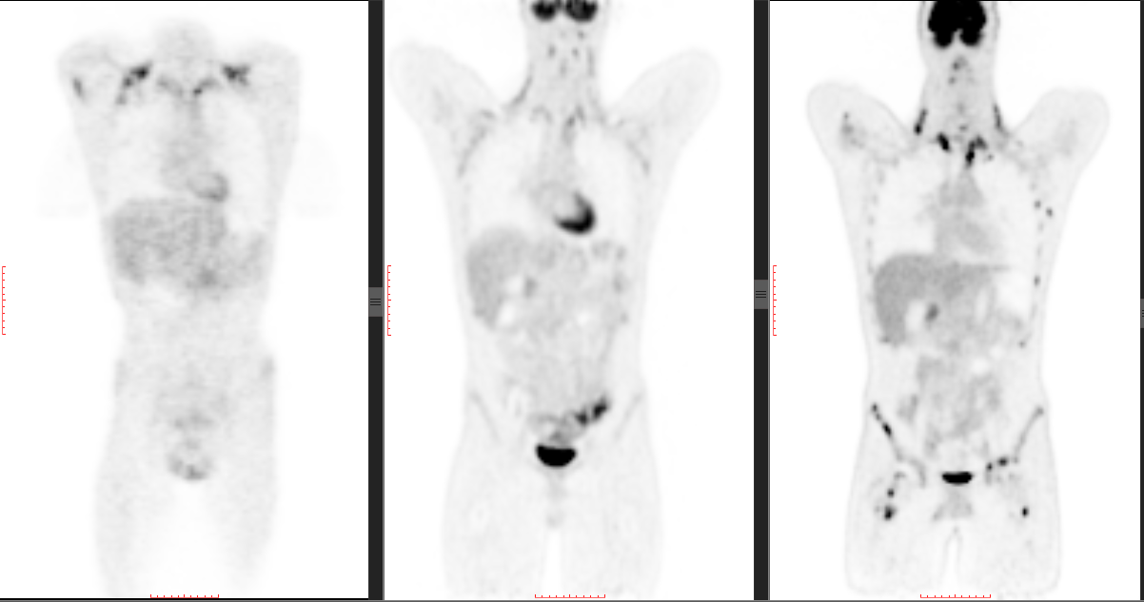
SCANNER CHANGE
SUV measurements will be affected
SAME PATIENT!!
A (No TOF)
B (TOF)
C (TOF and PSF)

Slide 9
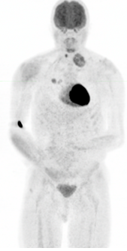
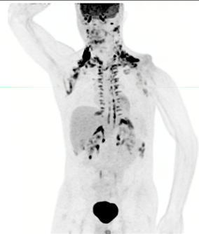
COMMON FINDINGS
Scanner change and physiologic findings
Brown (metabolically active) Fat
Injection site
SAME PATIENT!!

Slide 10
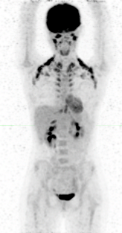
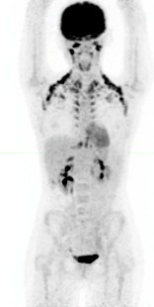
NO SUV RECONSTRUCTION
Different reconstruction
SAME PATIENT SAME VISIT
Unable to measure SUV
Able to measure SUV

Slide 11
Expectation
Collaborators should:
Identify when imaging is performed inconsistently, when altered biodistribution is suspected, or when SUV cannot be obtained

Slide 12
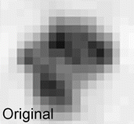
Common SUV Measures
Heterogeneous tumor uptake
How are lesions contoured?
How many?
What values are you collecting?
How does consistency/noise affect this measurement?
Image credit: Frings, et al. Radiology 2014 273:2, 539-548

Slide 13
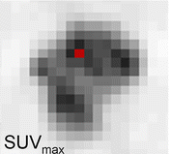
Common SUV Measures
SUVmax
Heterogeneous tumor uptake
Highest single voxel value within a lesion; sensitive to image noise
Was imaging consistent?
Are you considering the lesion with highest value within the patient?
Image credit: Frings, et al. Radiology 2014 273:2, 539-548

Slide 14
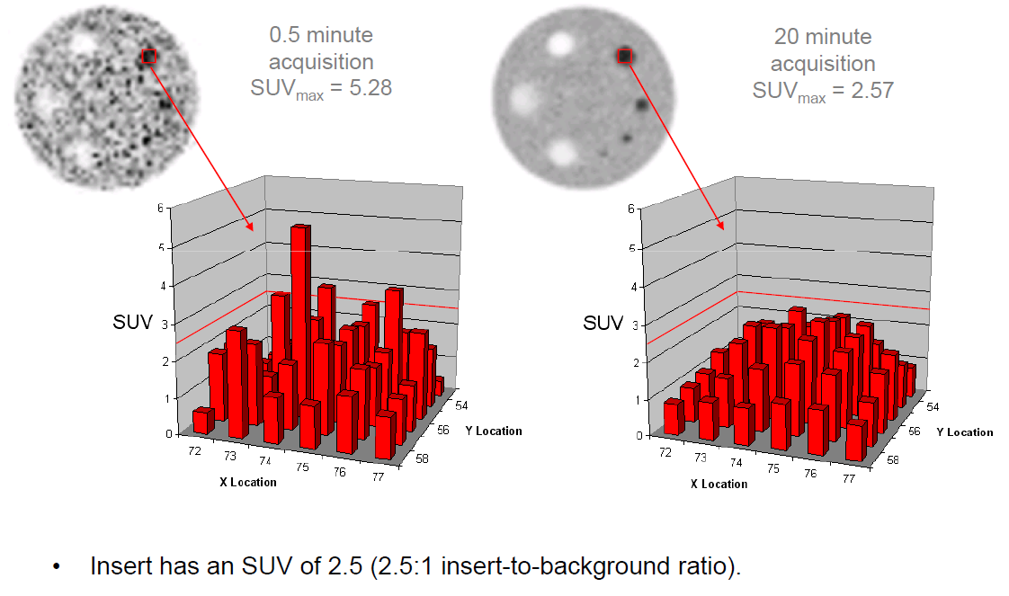
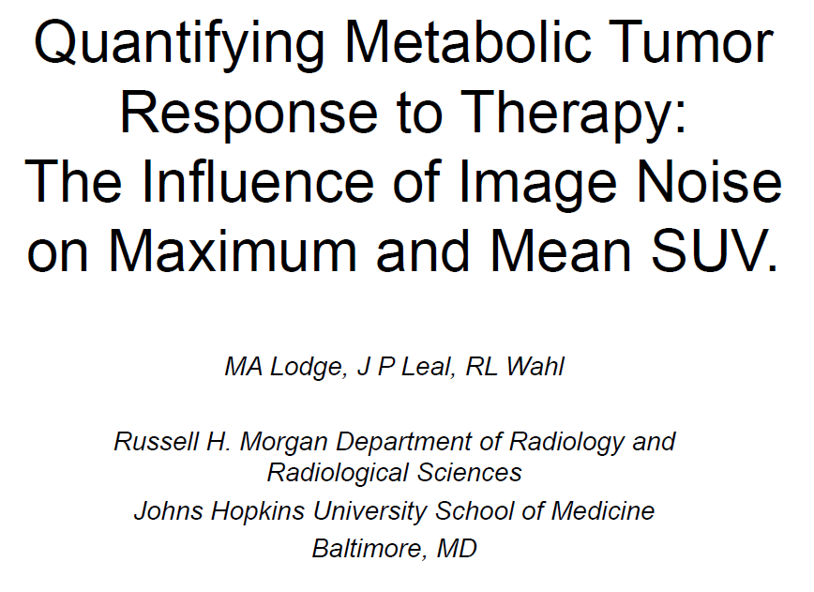
Common SUV Measures
SUVmax noise

Slide 15
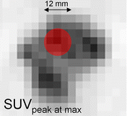
Common SUV Measures
SUVpeak
Heterogeneous tumor uptake
Average of voxels; considered less subject to image noise
Which definition of SUVpeak?
Average within a sphere centered on SUVmax, average of the hottest voxels, some other definition?
Image credit: Frings, et al. Radiology 2014 273:2, 539-548

Slide 16
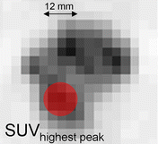
Common SUV Measures
SUVpeak—PERCIST definition
Heterogeneous tumor uptake
Average of voxels; considered less subject to image noise
If hottest voxels, then may not include SUVmax
May be located in a different position within the lesion…
Image credit: Frings, et al. Radiology 2014 273:2, 539-548

Slide 17
Expectations
Collaborators should:
Ensure image noise is minimized (create robust acquisition guidelines and ensure these are followed)
Have appropriate analysis tools available for reviewers

Slide 18
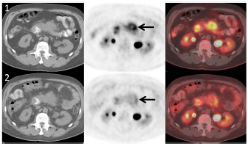
PERCIST Criteria
SUV changes to assess response to therapy
Recommends following the ‘hottest’ (most FDG avid) single lesion
Recommends using lean body mass corrected SUV (SUL)
Recommends assessing total lesion glycolysis (SULmean x volume of ALL disease within a patient)
41% reduction in SUL peak without significant change in tumor size
Image Source: https://www2.rsna.org/re/twotopicimagingworkshoppresentations/Index%20Files/Wahl.pdf

Slide 19
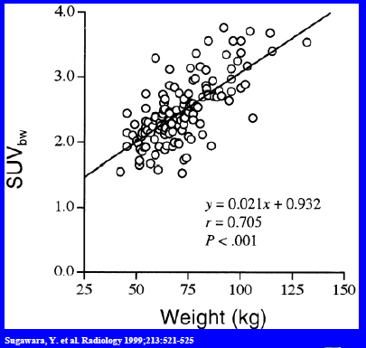
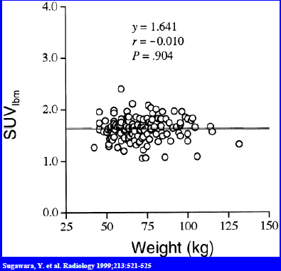
Why Lean Body Mass Corrected SUV?
Left - upward trend of liver SUVbw compared to patient size
Right - SUVlbm removes this upward trend

Slide 20
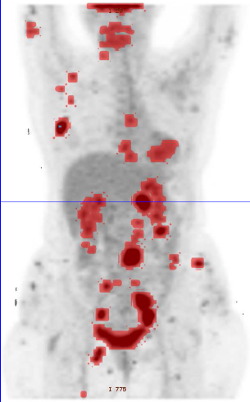
PERCIST
Provides guidance on measurement (SUL peak)
Defines quality control using normal liver SULmean
Recommends capture of additional lesions, metabolic volume and reporting of total lesion glycolysis
Is anyone using this criteria for analysis?
Image Source: https://www2.rsna.org/re/twotopicimagingworkshoppresentations/Index%20Files/Wahl.pdf

Slide 21
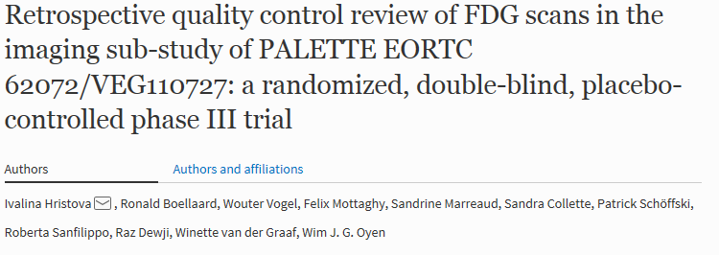
What happens when imaging is not consistent?
Current Literature—continuation of prior PINTAD discussion
Low compliance with the imaging guidelines compromised quantitative assessment
Liver SUVmean could be monitored to assess quality and compliance

Slide 22
Recommendations for Multicenter Trials
Current Literature
Ensure guidelines are current and spell out how to avoid variability
Anonymization process should not alter DICOM fields for SUV
Uptake time should be derived from midplane slice of the tumor
Perform rapid prospective quality review

Slide 23
Expectations
Collaborators should:
Assess Liver SUV as part of prospective quality control
Identify/report poor compliance early

Slide 24
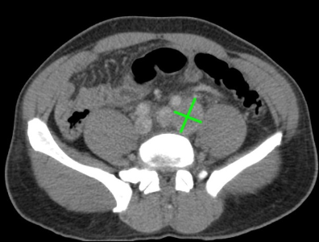
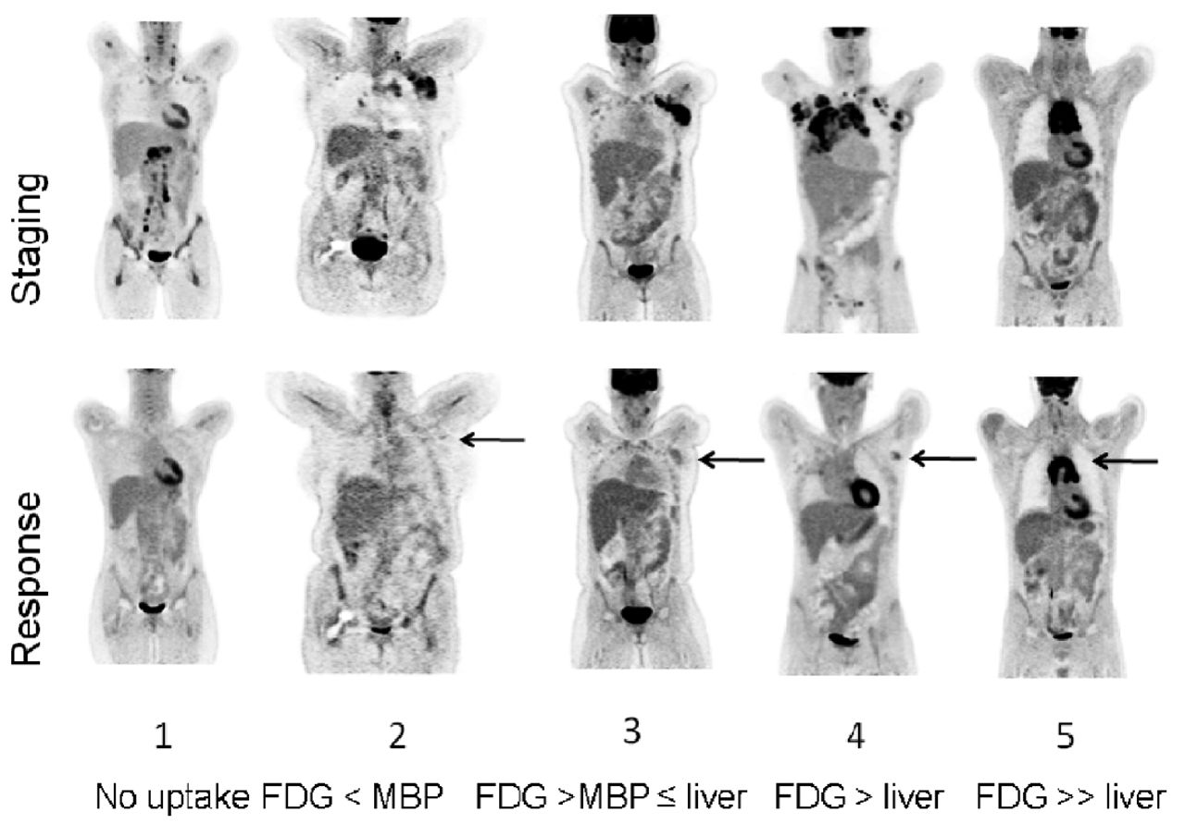
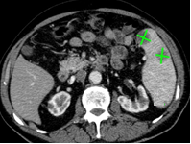
Lugano Lesion Assessments
Nodal measurement
PET 5 point scale
Extranodal measurement
Image credit: Josée M. Zijlstra et al. Haematologica 2016;101:1279-1283

Slide 25
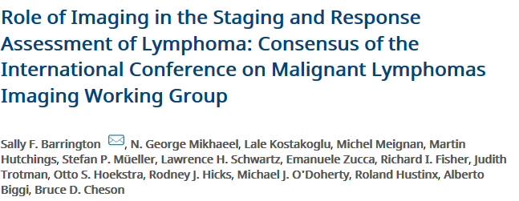
Specific Guidance on SUV use in Visual Scale
SUV should be referenced!
PET/CT images should be scaled to a fixed SUV display and color table
Score 4 be applied to uptake > the maximum SUV in a large region of normal liver
Score 5 is uptake 2× to 3× > the maximum SUV in the liver

Slide 26
Visual Lesion Assessment
Standardizing Image Windowing
Automatic presentation intensity
Adjusted presentation intensity

Slide 27
Expectations
Collaborators should:
Ensure SUVs can be measured during review sessions
Employ standardized window settings during image review

Slide 28
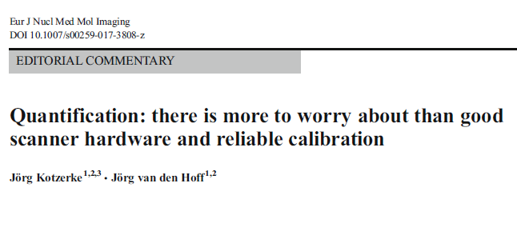
Other Approaches?
Target/Background
Compensate for variability with ratio approaches
Tumor to liver ratio (TLR)
Tumor to arterial blood standard uptake ratio (SUR)

Slide 29
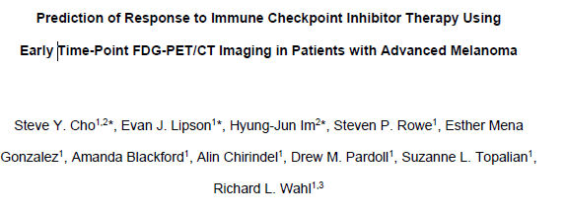
FDG PET/CT Role in Immunotherapy
Current Literature
Combination of structural and functional criteria appears predictive for eventual response to Immune Checkpoint Inhibitor tx in Melanoma

Slide 30
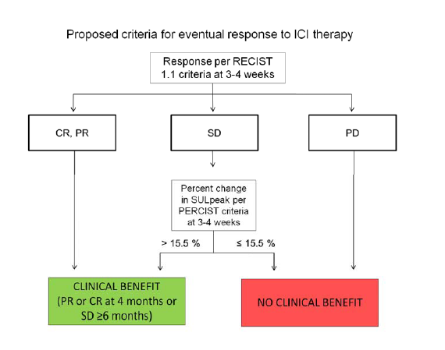
FDG PET/CT Role in Immunotherapy
Current Literature
Reviewed RECIST 1.1, irRC, PERCIST and EORTC
Hybrid PECRIT criteria
Reported 100% sensitivity, 93% specificity and 95% accuracy
Small study, low-dose/non-enhanced CT scans
Authors recommend further validation
Notes:
PET/CT Criteria for early prediction of Response to Immune checkpoint
inhibitor Therapy (PECRIT)

Slide 31
Does PINTAD Agree? Can we help improve FDG imaging?
Do the expectations here seem reasonable?
Are they achievable?
Sites/CROs/Sponsors will all need to be in agreement—all current recommendations are consistent with generally accepted standard of care FDG protocol
Will more site/technologist specific training help?
Does FDG have a role in general oncology therapy trials? In immunotherapy trials (i.e. LYRIC criteria for Lymphoma)?
Can CROs support more robust qualification/QC?
Standardization/harmonization efforts do exist (ACR, EARL, SNMMI-CTN, NCRI accreditation), could pharma/CROs look to help further these efforts?

Slide 32
Questions
Thank You!!

