Slide 1

The Future of Medical Imaging Research, Now.
PINTAD Webinar
March 2020

Slide 2
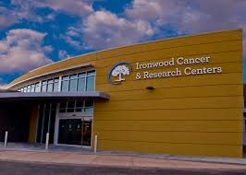
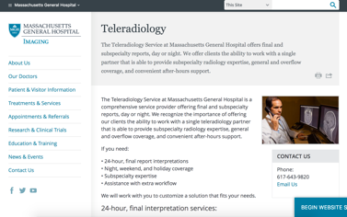

Imaging: Key for Data Driven Research & Therapy Development
  New healthcare providers catering to more specialized disease cohorts
  Care settings moving out of hospital
  Consumerization driving care decisions
  Multiple data types and data science making care personalized
  Investments focusing on data-driven healthcare
  Data size and complexity a key challenge
  Cloud access making data accessible
  Imaging data a key component in any data science initiative
  Real world evidence speeding therapy innovation
NEW CARE SETTINGS
NEW TOOLS
NEW THERAPIES

Slide 3
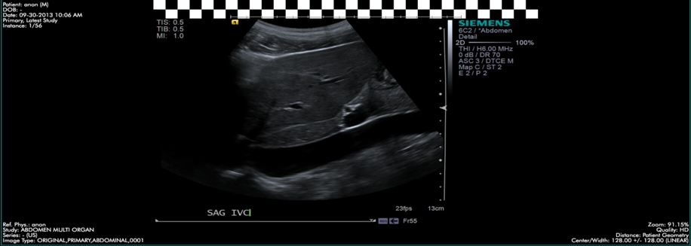
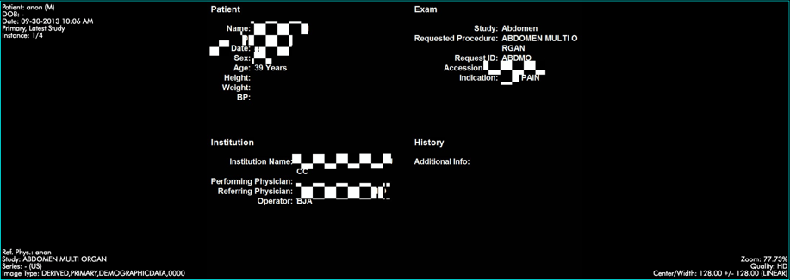
Image Sharing Platform for Life Sciences
DICOM & HL7 RESEARCH TOOLS
DE-ID’D DATA OUTPUTS
Custom upload fields (e.g. IDTF)
Validation rules & QC workflow
KOL workflow and eCRF forms
Downstream routing rules
DICOM tag, pixel and HL7 anonymization
Scripting platform
  Custom scripts for Q.C. checks
  Ability to plug-in outside A.I.
Advanced integrations/interoperability with 3rd party systems

Slide 4
Thank You

