Slide 1
Image Management and Data Sharing Platform Needs in Drug Development
03/27/2020
Özlem Yardibi, Associate Director
Imaging
Takeda Pharmaceutical Company Limited

Slide 2
Outline
Why do we need to bring images and image-derived data in-house?
A plethora of data transfer/management solutions currently in use
Possible technical and operational challenges in adopting new systems and solutions

Slide 3
The value of imaging data depends on how it is used and applied
Perform QC/QA of images for decision making before/during/after clinical trials
Help streamline better imaging studies by improving insights into the design and execution
Enable FAIR (Findable, Accessible, Interoperable, Reusable) data management
McKinsey Global Institute estimates that applying better data strategies to inform decision making could generate up to $100 billion in value for healthcare

Slide 4
Currently, robust and consistent image transfer remains to be elusive
A pretty common dialogue:
How would you like to transfer the images?
We can share them via FTP ..
Our IT does not allow FTP, they say it is not secure..
How about Box.com?
For 50GB of images??
Or perhaps we can send you a hard-drive……
Once you receive the data, plan for sharing with internal/external collaborators :-/

Slide 5
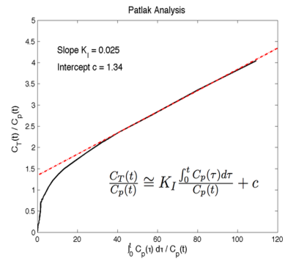
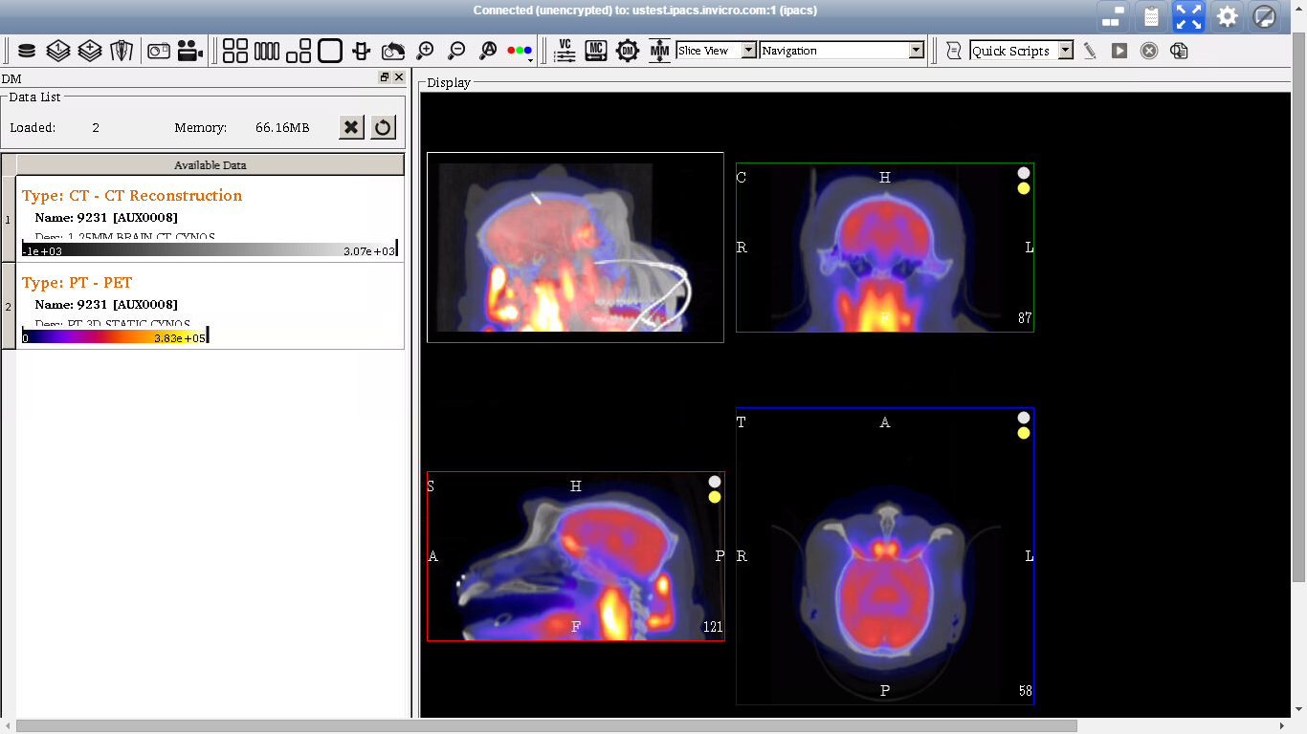
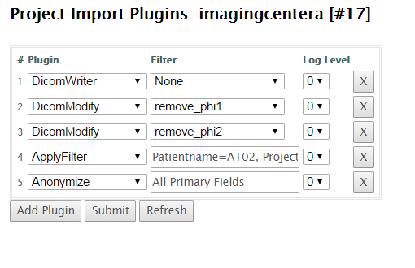
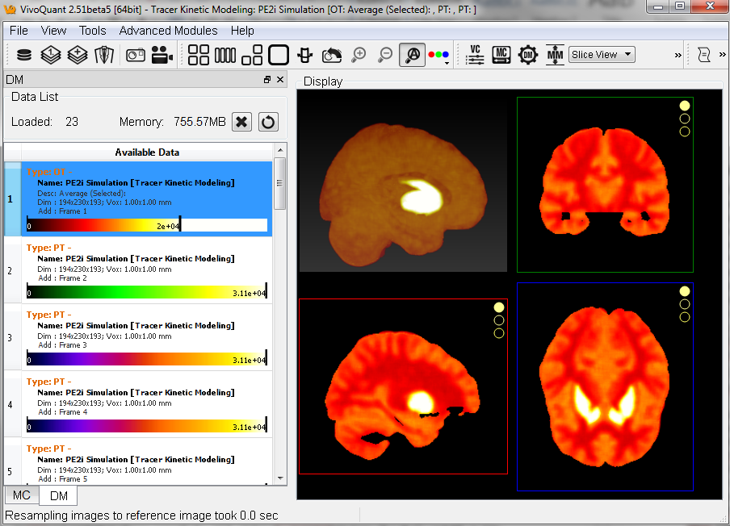
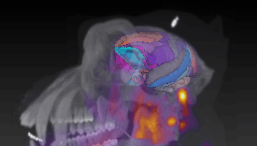
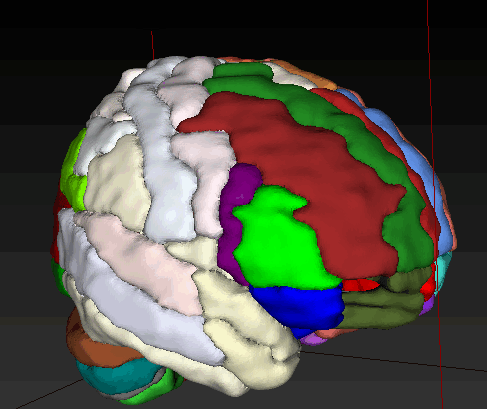
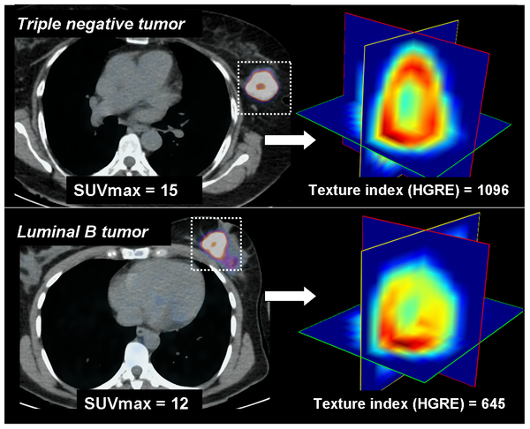
A possible lifecycle for image data in drug development
Multi-Imaging Centers or Labs or Imaging CROs or Academia or Public Databases
Provide access to remote colleagues, collaborators, vendors
Global Access in a Cloud Server
Internal Network
Capture data for QA/QC, further quantification or data mining

Slide 6
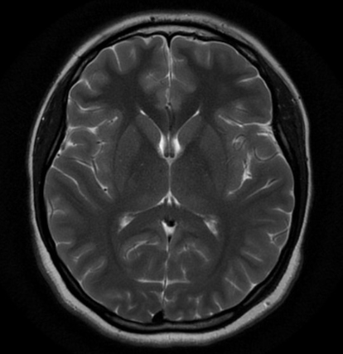
What are some technical and operational challenges?
IT
Restrictions
Data Integration
Cloud-Based Sharing
Data Sharing and Privacy Policies
Dedicated Support

Slide 7
THANK YOU

